Slide 1
Analogy of algorithm and Data Structures
Part 1

Slide 2

you will choose?

Slide 3
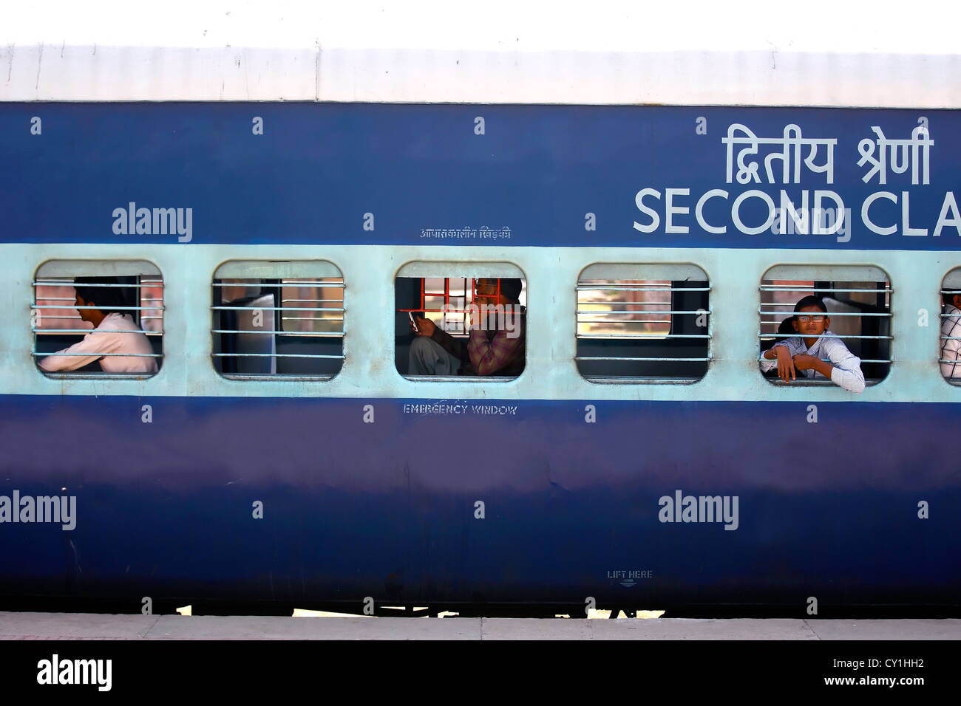
Linear Search

Slide 4
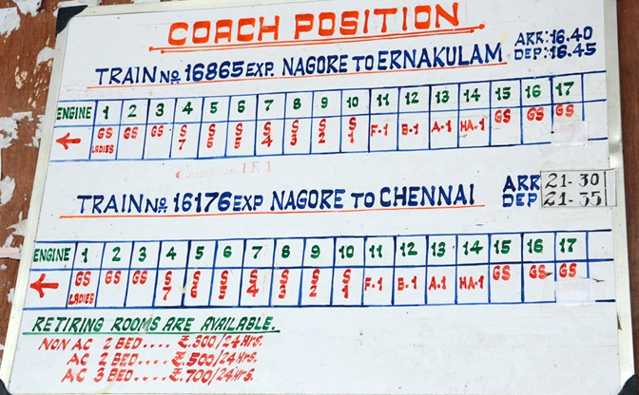
Object Mapping

